Slide 1

https://LifePregnancyCV.com/events/

Slide 2

https://LifePregnancyCV.com/events/

Slide 3

Striving for Joy
Philippians 3:1-14
Pastor Daniel Klem
Sunday, August 16, 2026

Slide 4
Philippians 3:1-3 – Quick recap
False teachers – “the dogs” – the wolves in sheep’s clothing
  Matthew 7:15-20 (false prophets, known by fruit)
  Acts 20:29 (Paul told the Ephesians wolves would come in)
  Matthew 10:16 (Jesus says to be shrewd as serpents yet innocent as doves amongst wolves)
Circumcision – physically pushed by false teachers, but the circumcision of the heart (Deuteronomy 10:16, 30:6; Jeremiah 4:4; Romans 2:29) leads to true worship in Spirit and Truth
Ladders – Which wall? Human effort or the Way?

Slide 5
Philippians 3:4-8 – Paul’s “credentials”
vv. 4-6 – Starting with the Ladder of the Flesh – Worldly pursuits
  “blameless according to the Law”:
    Born an Israelite, of the tribe of Benjamin
    Circumcised on the 8th day
    Strict Pharisee with zeal for the Law and …
    Persecuted the Church to “defend God’s honor”
  Compared to the “dogs’” worldly ladder, Paul has it all …
vv. 7-8 – Compared to knowing Christ:
  “hyper-echon” (ὑπερέχον) – “excellency/surpassing worth” = literally “beyond having”
  “skubalon” (σκύβαλον) – “dung/rubbish” = animal/street waste

Slide 6
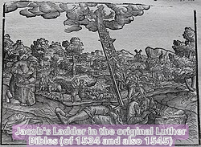
Jacob’s Ladder?
Genesis 28:10-13,16-17
John 1:51 –
And Jesus said to Nathanael,
“Truly, truly, I tell you, you will see heaven opened, and the angels of God ascending and descending on the Son of Man.”
  John 14:6 – “I am the Way, the Truth, and the Life …”

Slide 7

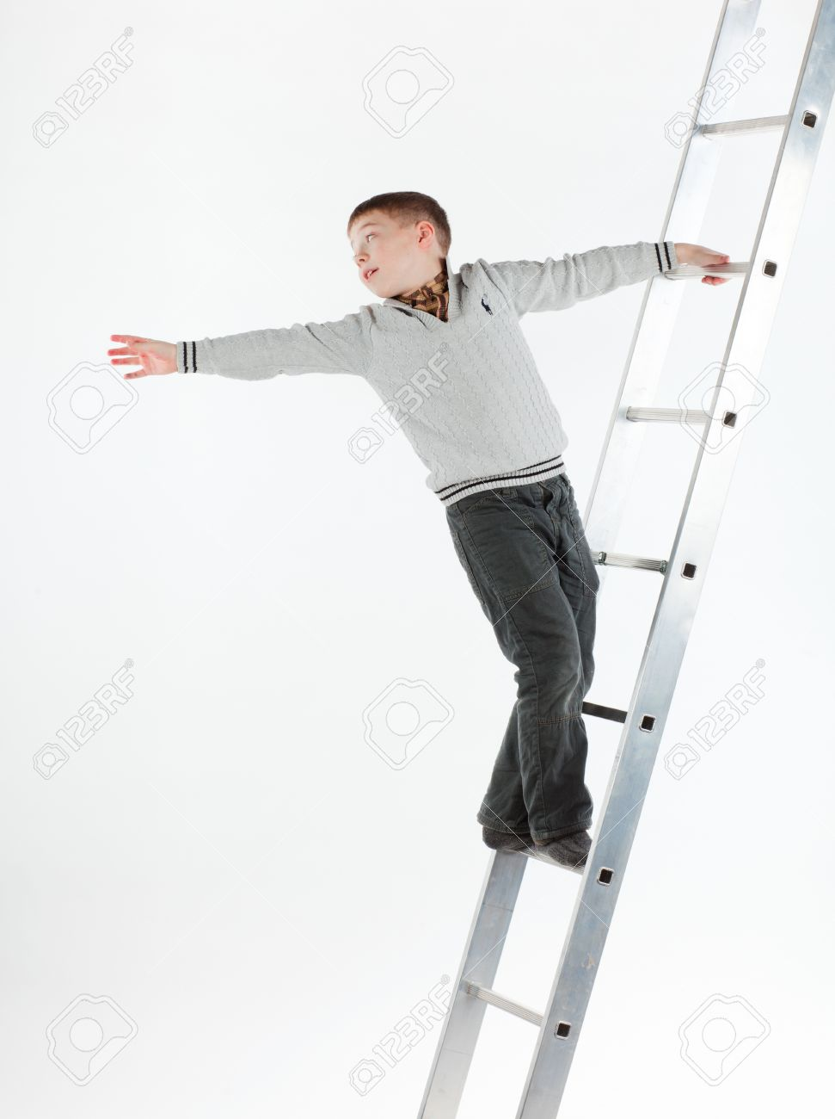
Philippians 3:8-11 – The Best Ladder
Christ “lost” His life that by faith in His death and resurrection we lose our lives to be raised in His resurrection
Adding to/Taking from the gospel is like grabbing another ladder:
  Putting up another ladder:
  “I don’t need Christ”
  “This is the Jesus I like”
  This does not lead to Eternal life!
  Grabbing another ladder while holding Christ:
  “Jesus is cool, but this other thing looks good, too”
  “Jesus isn’t quite enough. I think I need some of …”

Slide 8

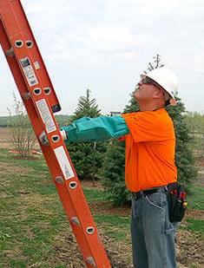
Philippians 3:12-14 – Ascending in Christ
v. 12 – In this life, we will always be “working out salvation” (2:12)
vv. 13-14 – Stop trying to grab other ladders!
  Stay focused on Christ!
  Help each other up! (Jude 22-23)
  Join pastors & the Holy Spirit
  in holding the ladder steady!
The joy of the Lord is staying focused
on Christ, our ladder and destination!
Don’t be overly concerned with works,
but love God by loving people according
to God’s Word and Christ’s Example.

