Slide 1
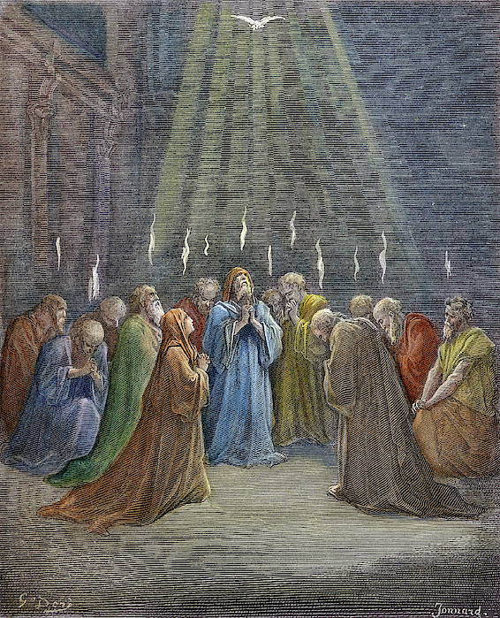
Examples of Living Like Christ
Philippians 2:19-30
Pastor Daniel Klem
Sunday, August 2, 2026
“Holy Spirit” – Gustave Dore

Slide 2
Matthew 25:14-30 – Three Servants
The three servants of the master:
  5 Talents → Gets five more
  2 Talents → Gets two more
  1 Talent →Buried the talent, made excuses
The responses of the master:
  “Well done, good and faithful servant”
  “Cast the worthless servant into the outer darkness”
Philippians – Some preach selfishly or from envy, but we focus on Christ

Slide 3
Philippians 2:19-30 – Two Examples of Christ’s Mind
Timothy – Co-author, fellow servant (1:1), & one who cares (splanchna!)
  Paul & Timothy have “anxiety” or concern for the Philippians
  v. 21 – Unlike those with false pretenses, he seeks Christ first
  vv. 22-24 – Timothy has proven himself faithful
    He is trusted by Paul and the Philippians while life may be shaky

Slide 4
Philippians 2:19-30 – Two Examples of Christ’s Mind
Epaphroditus – A fellow servant, soldier, and Philippian (4:18)
  Messenger – “apostolon” = apostle = “sent one”
    “Apostle of Christ” vs. “apostle for a congregation”
    [Beware those who equate themselves with the Apostles (2 Cor. 11)]
    Sent to help Paul, returning with the letters from Paul
    (Eph. 6:21; Col. 4:7 – carried and read by Tychicus)
  vv. 26-30 – Was sick to death
    [Beware those who teach perfect healing or needing more faith!]
    Because of his work for the gospel

Slide 5
Philippians 2:19-30 – Two Examples of Christ’s Mind
Timothy – Like the servant with 5 Talents
  Proven faithful, becomes the lead pastor/bishop of Ephesus
  (1 Timothy, esp. 1:2-3)
Epaphroditus – Like the servant with 2 Talents
  Trusted to help Paul and other leaders
The other preachers (1:15-18) – More like the servant with 1 Talent
  Either hiding the gift or misusing the gift (Matthew 7:15-23)

Slide 6
Philippians 2:19-30 – Two Examples of Christ’s Mind
Like Timothy – Pastors/Elders
  We are all called to this standard (2:1-5)
Like Epaphroditus – Deacons/Deaconesses (Literally “servants”)
  We are all called to be servants to one another
Like the other preachers (1:15-18) – Those who lose focus on Christ
  Complain and Grumble (2:14)
  Teach each other with wrong motives (1:15)
  Serve out of compulsion or legalism

Slide 7
Philippians 2:19-30 – Being Examples of Christ’s Mind
Not like the other preachers (1:15-18) – Remain focused on Christ
  Encourage and help
  Teach each other (with good) motives
  Serve willingly out of love for Christ and each other
Like Timothy – Live lives worthy of the gospel (1:27), working out your salvation faithfully (2:12-13)
Like Epaphroditus – Have deep affection and concern for each other, not only looking to your own needs but to the needs of others (2:1-5,21)

Slide 8
In Summary …
Live lives faithful to Christ
Live lives devoted to each other
Live gospel-centered lives, wanting the best for all, especially leading others to Christ

