Slide 1
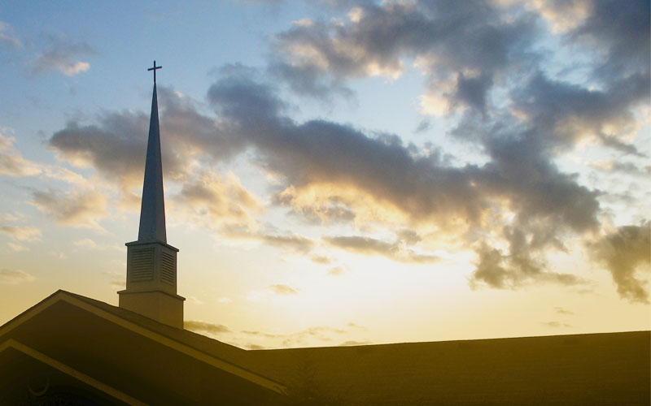
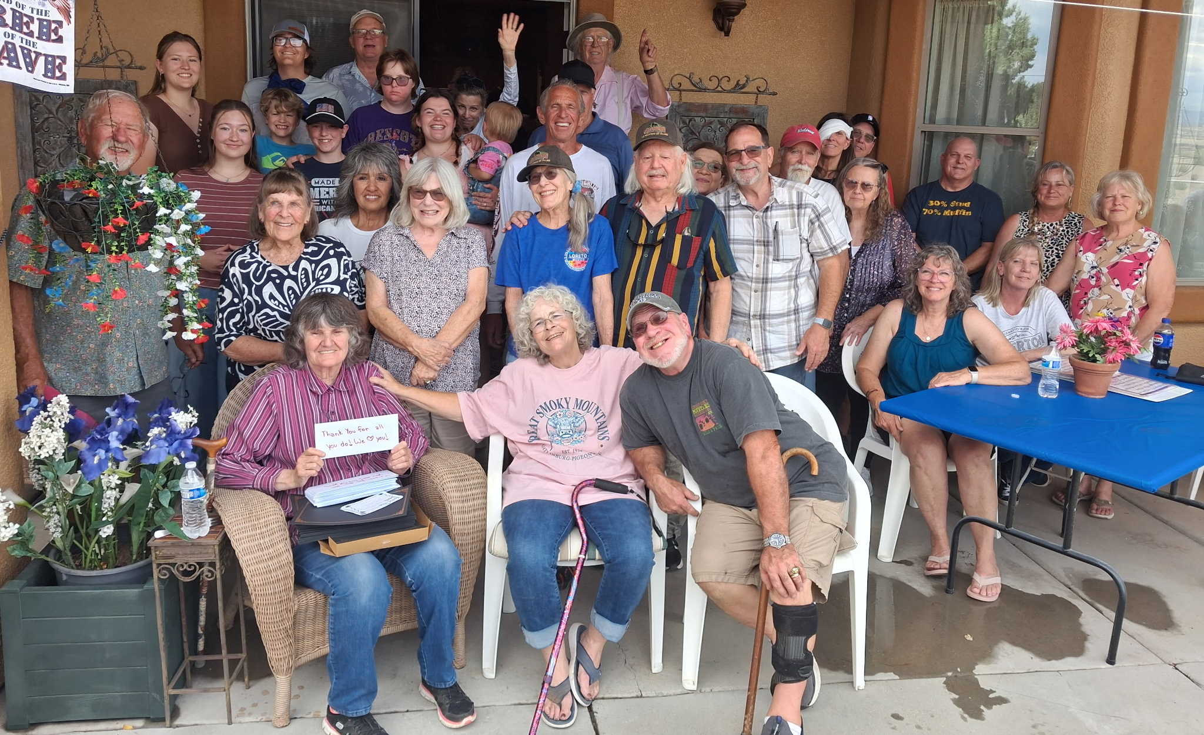
Notes:
Paulden Food Bank Volunteer Appreciation, June 13, 2026

Slide 3
The Joy of Church: Part 2
Philippians 1:7-11
Pastor Daniel Klem
Sunday, June 14, 2026

Slide 4
Philippians 1:1-6
Prayer of/in gratefulness and joy (eucharisteo)
Ekklesia – “the gathered ones” or “those invited/called out together”
Koinonia – “fellowship” or “participation”
Love and Faith
  The Gospel = “God so loved the world” (John 3:16), so we love like Him (1 John 4:19)
    The Word = The Bible, Commands, Jesus (John 14:15)
  One another = out of His love (John 13:34-35)

Slide 5
Philippians 1:7-11
Partakers
Proclaim
Protect
Prayer

Slide 6
Philippians 1:7-11
Partakers (synkoinonous = syn – “with/alongside” + koinonia – “fellowship/participation/partnership”)
  Proclaiming the gospel – why Paul is imprisoned
  Protecting (defending) the gospel and the Church
    Apologia = “legal defense” or “speak up for”
    Literally, “from/by reason/logic/the word”
  Prayer
    Yearning and love
    Knowledge and discernment
    Hope and righteousness of Christ

Slide 7
Partakers in Prayer
Prayer literally means “asking” (“Pray, tell.”)
  Conversation – Talking with/about those you love
  Drawing near – Time with those you love
  (Luke 5:16)
  Inviting change – Wanting to be better, repentant
  (Romans 12:2)
  Thinking like the other – Unity in thought
  (Matthew 26:39; Acts 2:42-47; Philippians 2:5; Romans 12:2)

Slide 8
Partakers in Prayer
Partakers in:
  Proclaiming the Word over each other
  Proclaiming the Word to others
  Protection by God
  Needs
    Healing
    Hope
    Hardships

Slide 9
Lord, grant peace and wisdom at this time. Remind me of Your faithfulness and goodness, and help me to trust You more.
Heavenly Father, stretch out Your hand and heal my body today. I know You can heal and restore, and I will have faith in You even if I must suffer for Your glory, yet I ask for Your healing touch today.
Gracious God, grant me wisdom and strength to move forward. I don’t know what to do, but I know You hold the future in Your hands. Guide me and help me know You are near.

Slide 10
The Lord’s Prayer – Matthew 6:9-13, KJV
Our Father which art in heaven, Hallowed be thy name.
Thy kingdom come, Thy will be done in earth,
as it is in heaven.
Give us this day our daily bread.
And forgive us our debts, as we forgive our debtors.
And lead us not into temptation,
but deliver us from evil:
For thine is the kingdom, and the power,
and the glory, for ever.
Amen.

Slide 11

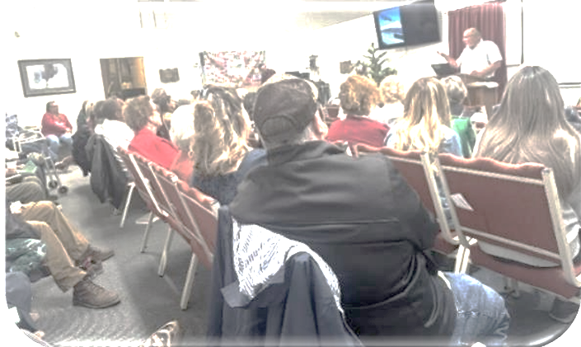
The Joy of Church
We are all in this together
We should pray and give thanks for our local congregation and the global Church
We join in the work of the gospel together
We share in the hope of the return of Christ

