Slide 1
The Joyful Life:
The Letter to the
Philippians
A brief overview.
Pastor Daniel Klem
Sunday, May 31, 2026

Slide 2
Philippians: Who, when, where …
Philippi
  357 BC – Founded by Philip II of Macedonia (Alexander the Great’s dad)
    Originally called Krenides, “The Springs”
    Gold and silver mines
  42 BC – Antony and Octavian defeat Brutus and Cassius, uniting the Roman Empire under Octavian Augustus
    Soldiers allowed to settle as a colony of Rome, making them Italians and Roman citizens.

Slide 3
Philippians: Who, when, where …
Philippi
  Acts 16
    Paul called by God to Macedonia
    Meets Jewish merchant Lydia and friends (vv. 12-15)
    Casts out a serpent spirit from a girl, then beaten and thrown in jail (vv. 16-24)
    The jailer comes to faith (vv. 25-34)
    Paul uses his Roman citizenship, and is asked to leave (vv. 35-40)

Slide 4
Philippians: Who, when, where …
Philippians – Part of the “Prison Epistles”
  Ephesians, Philippians, Colossians, Philemon
  Grouped with Galatians

Slide 5
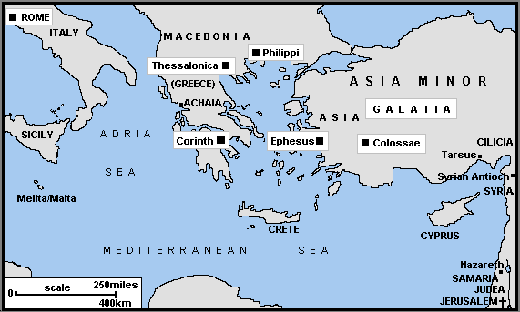

Slide 6
Philippians: Who, when, where …
Philippians – Part of the “Prison Epistles”
  Ephesians, Philippians, Colossians, Philemon
  Grouped with Galatians
  Galatians is Paul’s angriest letter
    1:6 – “I am astonished that you are … deserting him … for another gospel”
    3:1ff – “O foolish Galatians!” “Are you … Did you …”
    5:12 – “I wish [they] … would emasculate themselves!”

Slide 7
Philippians: Who, when, where …
Philippians – The happiest letter
  Authored by Paul with Timothy
    Like 2 Corinthians, Colossians, 1 & 2 Thessalonians, and Philemon
  Agreed to most likely be AD 61-62 from Rome
    4:21 – “… those of Caesar’s household.”
    1:21-23 – “die is gain … depart, and be with Christ”
  Thankfulness for the Philippians
    1:3-11; 4:10-23

Slide 8
Philippians: Compare & Contrast
Philippians – The happiest letter
  In agreement with the angriest:
  Galatians 6:11-18
    Paul shares the same concerns in Philippians
    The Philippians are doing better than the Galatians!

Slide 9
Philippians: Paul’s (& Our) Joy
Philippians – The happiest letter – Joy, Grace, Thanks, Rejoice – 23 times – χάρις (charis)
  Ch. 1 – Thankfulness and the Gospel
    vv. 12-14
    vv. 18-21, 27
  Ch. 2 – Living like Christ
    vv. 2,4-5
    vv. 12-13

Slide 10
Philippians: Paul’s (& Our) Joy
Philippians – The happiest letter – Joy, Grace, Thanks, Rejoice – 23 times – χάρις (charis)
  Ch. 1 – Thankfulness and the Gospel
  Ch. 2 – Living like Christ
  Ch. 3 – Christ’s Righteousness in Us
    v. 1
    vv. 2-3 (warning from Galatians)
    vv. 8-12
  Ch. 4 – Rejoice in God and Each Other in Christ
    vv. 4, 8, 10-13

Slide 11
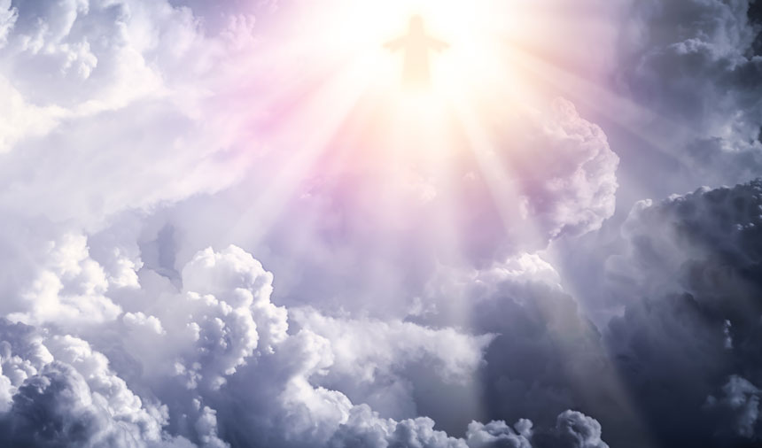
Philippians: The Whole Point
Philippians 4:4 and 2:9-11 (mostly ESV)
Rejoice in the Lord always; again I will say, rejoice, for God has highly exalted him and bestowed on him the name that is above every name, so that at the name of Jesus every knee should bow, in heaven and on earth and under the earth, and every tongue confess that Jesus Christ is Lord, to the glory of God the Father.

