Slide 1
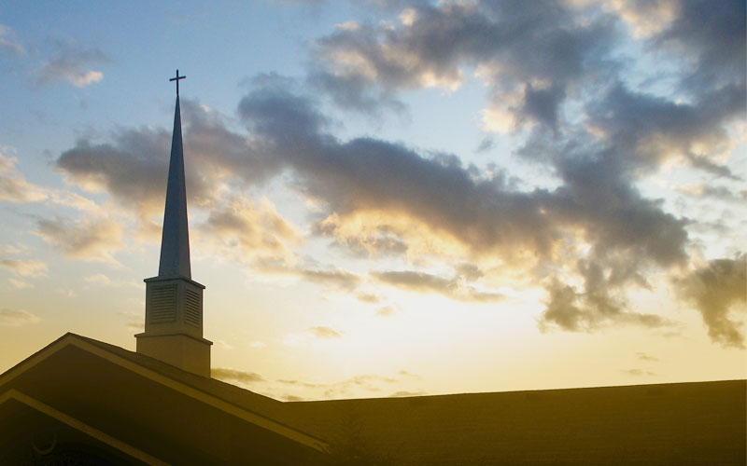
The Joy of Church: Part 1
Philippians 1:1-6
Pastor Daniel Klem
Sunday, June 7, 2026

Slide 2
Philippians 1:1-2
From Paul and Timothy, slaves (douloi) of Christ
  Doulos = “slave” or “bondservant” or “servant”
    Can refer to actual slaves, also, today: “employee”
To ALL the saints
Also to the elders (episkopois) and deacons (diakonois)
  Episkopos = root of “episcopal” and means “overseer”
  Diakonos = root of “deacon” and means “servant”
Grace (charis) and peace (eirene) from God

Slide 3
Philippians 1:3-5
“I give thanks” – Eucharisto –
“I am grateful/thankful/blessed”
  “in all my remembrances”
  “in all my prayers”
  “with joy” – “meta charas”
  “because of your fellowship in the gospel”
    Koinonia – “fellowship” or “participation”
    1 John 1:3; 1 Corinthians 1:9; 2 Corinthians 13:13,14; Acts 2:42-47

Slide 4
Philippians 1:3-5
“because of your fellowship/partnership in the gospel”
  What is the gospel?
  Good creation by a good God
  The Fall from human sin (Genesis 3; Romans 3)
  God came as a man (Jesus): lived a perfectly obedient life, died on a cross in our place, rose to life again and ascended to the Father. (Philippians 2:5-11; 1 Corinthians 15)

Slide 5
Philippians 1:3-5
“because of your fellowship/partnership in the gospel”
What is the Church? (ekklesia)
  Ekklesia = ek – “out” + kaleow – “called/summoned/invited” → “those [called out or summoned or invited] together” or “gathered ones”
  Matthew 16:13-19 – Built on Christ, fight evil
  Matthew 18:15-20 – Call out sin (for repentance)
  Matthew 28:18-20 – Make Christians (disciples)
  Acts 2:42-47 – Koinonia in the Word (Eph. 2:17-22)

Slide 6
Philippians 1:3-5
Psalm 95:6-7, ESV: Oh come, let us worship and bow down; let us kneel before the Lord, our Maker! For he is our God, and we are the people of his pasture, and the sheep of his hand.
Psalm 50:5: “Gather to me my faithful ones, who made a covenant with me by sacrifice!”
Psalm 40:9a: I have told the glad news of deliverance in the great congregation

Slide 7
Philippians 1:3-5
Psalm 122:1: I was glad when they said to me, “Let us go to the house of the Lord!”
Psalm 133:1: Behold, how good and pleasant it is when brothers dwell in unity!

Slide 8
Philippians 1:6
“I am confident / sure of” – confident in God’s work
“He who began a good work in you” – plural, all y’all – the work of the gospel:
  Grace to humanity, salvation, fellowship
“will perfect it / bring it to completion / perform it”
– God finishes what He starts
– “It is finished.” (John 19:30)
“in/until the Day of Christ Jesus” – the hope of Christ’s return and the complete restoration (Hebrews 10:23-25)

Slide 9

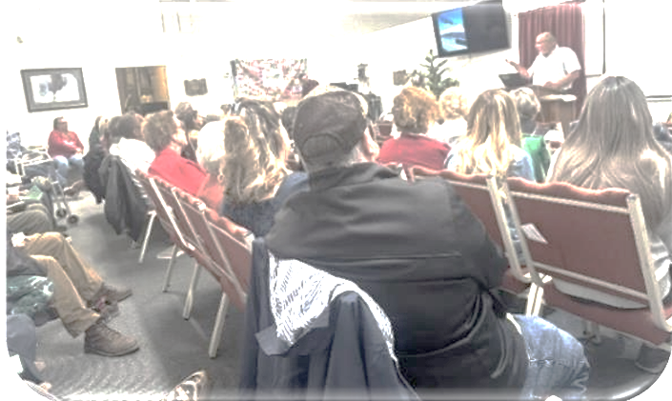
The Joy of Church
We are all in this together
We should pray and give thanks for our local congregation and the global Church
We join in the work of the gospel together
We share in the hope of the return of Christ

