Slide 1
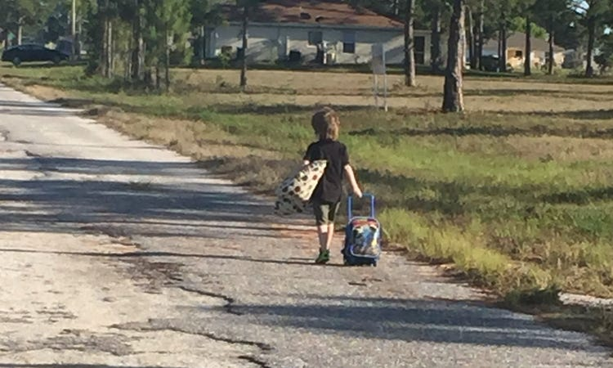
Walking In,
Not Running Away
Galatians 6:6-10
Pastor Daniel Klem

Slide 2

Galatians 6:6-10
What this is not saying (Flesh) – Sowing & Reaping:
  Sow a financial seed to get God’s blessings (v. 7 only)
  (Give to get, “Name it and claim it”)
  Do good to have it good (v. 7 only)
  (The Secret, “Fake it ‘til you make it”)
  Obey to receive salvation (vv. 6-8)
  (The Judaizers/Legalism)
  Blindly obey your leaders (vv. 6-8)
  (Never question, “Touch not the Lord’s anointed”)

Slide 3
Galatians 6:6-10
Not running away (Why people “deconstruct”):
  “Churches/Pastors are selfish”
  (only in it for the money)
  “Felt like I never had enough faith”
  (faking it never worked/felt like I was lying)
  “I never measured up”
  (could never do enough, kept falling short)
  “No one talked about …” or “I was controlled”
  (no freedom)

Slide 4
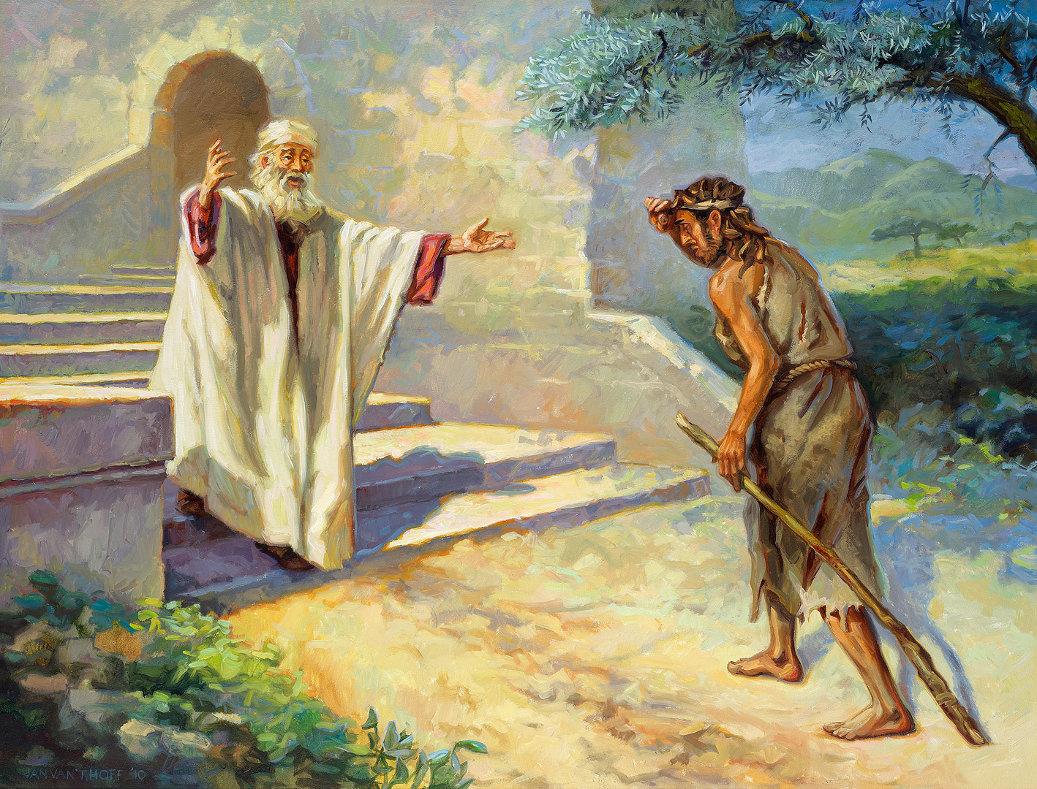
Galatians 6:6-8
We should support pastors
(v. 6; Ephesians 4:11-12; 1 Timothy 5:17-18)
  Deacons primarily serve, but should understand the Gospel/Bible
  (1 Timothy 3:8-13; Acts 6-7)
  Pastors/Elders also serve, but must have a good understanding of the Gospel/Bible and be able to teach
  (1 Timothy 3:1-7; 2 Timothy 4:1-2; Titus 1:5-9)
  We are all called to teach each other!
  (Ephesians 4:13-16; Colossians 3:16-17; 1 Thessalonians 5:8-11; Hebrews 10:23-25)
1 Corinthians 3:6 (Mark 4:1-29) – We sow the gospel and reap Life!

Slide 5
Galatians 6:9-10 – Because we are saved …
We lovingly support each other by the power of the Holy Spirit
  Physically and Financially (Acts 2:44-45)
  In Truth & Works (Matthew 5:13-15; Ephesians 4:13-16; Colossians 3:16-17; 1 Thessalonians 5:8-11; Hebrews 10:23-25)
  For Christ – Colossians 3:12-25

Slide 6
Colossians 3:12-17, ESV
Put on then, as God's chosen ones, holy and beloved, compassionate hearts, kindness, humility, meekness, and patience, bearing with one another and, if one has a complaint against another, forgiving each other; as the Lord has forgiven you, so you also must forgive. And above all these put on love, which binds everything together in perfect harmony. And let the peace of Christ rule in your hearts, to which indeed you were called in one body. And be thankful. Let the word of Christ dwell in you richly, teaching and admonishing one another in all wisdom, singing psalms and hymns and spiritual songs, with thankfulness in your hearts to God. And whatever you do, in word or deed, do everything in the name of the Lord Jesus, giving thanks to God the Father through him.

Slide 7
Colossians 3:18-25, ESV
Wives, submit to your husbands, as is fitting in the Lord.
Husbands, love your wives, and do not be harsh with them.
Children, obey your parents in everything, for this pleases the Lord.
Parents, do not provoke your children, lest they become discouraged.
Employees, obey in everything those who are your earthly bosses, not by way of eye-service, as people-pleasers, but with sincerity of heart, fearing the Lord.
Whatever you do, work heartily, as for the Lord and not for men, knowing that from the Lord you will receive the inheritance as your reward. You are serving the Lord Christ. For the wrongdoer will be paid back for the wrong he has done, and there is no partiality.

Slide 8
Jude 20-25
But you, beloved, building yourselves up in your most holy faith and praying in the Holy Spirit, keep yourselves in the love of God, waiting for the mercy of our Lord Jesus Christ that leads to eternal life.
And have mercy on those who doubt; save others by snatching them out of the fire; to others show mercy with fear, hating even the garment stained by the flesh.
Now to him who [in the Holy Spirit] is able to keep you from stumbling and to present you blameless before the presence of his glory with great joy, to the only God, our Savior,
through Jesus Christ our Lord, be glory, majesty, dominion, and authority, before all time and now and forever.
Amen.

