Slide 1


Slide 2
Bearing Burdens
Galatians 6:1-5
Pastor Daniel Klem

Slide 3
What does it look like?
Galatians 6:1-5
Galatians 1-5
  There is one gospel
  Believers hold each other accountable
  We are not saved by our works but by the work of Christ
  We should stop living according to the flesh
  We should live by the Holy Spirit
    Love, Joy, Peace, Patience (Longsuffering/Forbearance), Kindness, Goodness, Faithfulness, Gentleness (Meekness), Self-Control (Temperance)
  We crucify our flesh(ly desires and passions)

Slide 4
Bearing our burdens
Galatians 6:5
  We each are ultimately responsible for our own sin.
  Galatians 6:3-4 – Personal humility
    2 Corinthians 12-13 (esp. 12:9-10)

Slide 5
i am meeng
meeng is power
meeng is strength
meeng is awesome
meeng is great
meeng is joyous
meeng is more
meeng is sad
meeng is sore
meeng
is the
power of
GOD
Meek + Strong = GOD
(meeng)

Slide 6
Bearing our burdens
Galatians 6:1
  The fruit of the Spirit: Bring joy, faithfulness, and self-control to each other through lovingly, patiently, and gently correcting and restoring to goodness and the peace of God.
    2 Corinthians 5:11-21 – Ministers of Reconciliation
Galatians 6:2

Slide 7
Bearing each Others’ Burdens…
When we are wronged:
Joseph (Genesis 37-50)
David (1 Samuel 18-31)
  Abigail (1 Samuel 25)
The Prophets
Jesus!

Slide 8
Bearing each others' burdens…
When we feel ashamed and lonely:
The Woman @ the Well (John 4)
The Woman w/ bleeding
(Luke 8:40-48)
Job (2:11-13)
Peter (John 21:15-22)

Slide 9
Bearing each Others’ Burdens…
When life is hard:
Job
Sarah, Rachel, Hannah, Naomi, the Shunammite woman, Elizabeth
Elijah
Paul (Galatians 4:13-14,
Acts 13-14)

Slide 10
Bearing Each Others’ Burdens
Just be there
Listen & Understand
Rebuke, Correct, & Restore biblically (2 Timothy 3:16-17; Galatians 2:11-14; Matthew 18:15-20)
Lather, rinse, repeat … and repeat … (Matthew 18:21-35; 1 Corinthians 6:11; Hebrews 10:22-25)

Slide 11
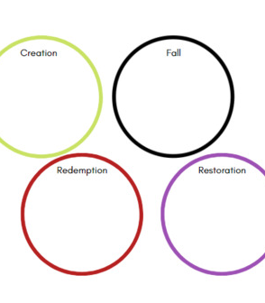
Christ’s Burden
Attacking Hell!
Given dominion
Gave up dominion
  “You will be like God” … hide … separate … hand over to Satan
Christ’s Battle:
The Great Commission

