Slide 1
Happy Resurrection Sunday!
Slaves & Sons – Galatians 4
Pastor Daniel Klem
Easter Sunday, April 5, 2026

Slide 2
Law vs. Promise
Galatians 3
  Personal faithfulness vs. God’s faithfulness
  Obedience to the Letter vs. Faith in the Word
  Adherence to tradition vs. Love of God, people, & the Church

Slide 3
Law vs. Promise
Galatians 4
  vv. 1-7: Slaves vs. Heirs
  vv. 8-20: Slaves to Law vs. Slaves to Love
  vv. 21-31: Son of Religion vs. Son of Promise

Slide 4
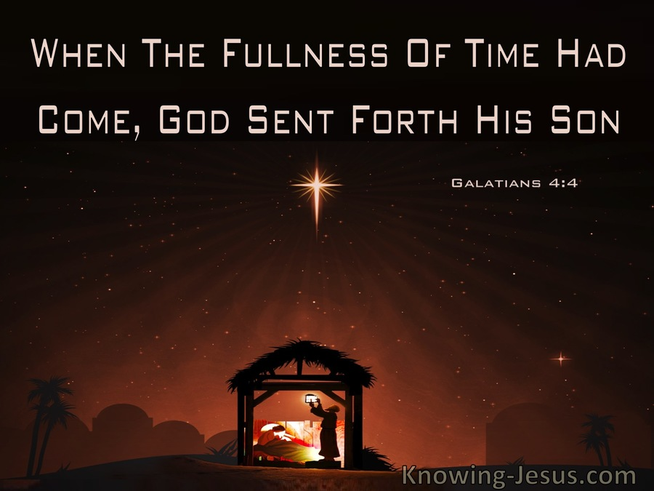
Law vs. Promise – Slaves vs. Heirs
Galatians 4:1-7
  Slaves and the immature need guidance
  “fullness of time” = just the right time
  Adopted through the Son

Slide 5
Law vs. Promise – Traditions vs. Truth
Galatians 4:8-20
  vv. 8-9 – Enslaved to “not gods” and “elemental spirits/forces/principles or elements of the world”
  vv. 10-11 – Celebrate times
  vv. 12-20 – Traditions vs. Truth and Love

Slide 6
Law vs. Promise – Slaves and Sons
Galatians 4:21-31 – Claims to Abraham
  Genesis 25 (and chs. 15-16, 21)

Slide 7
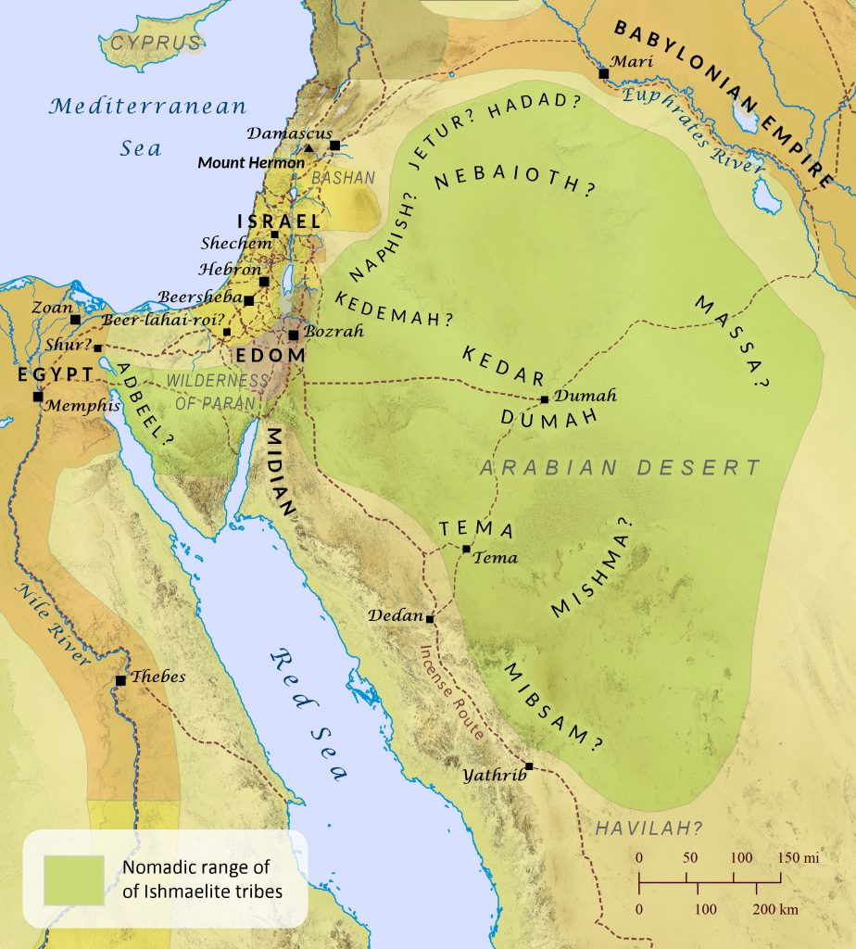
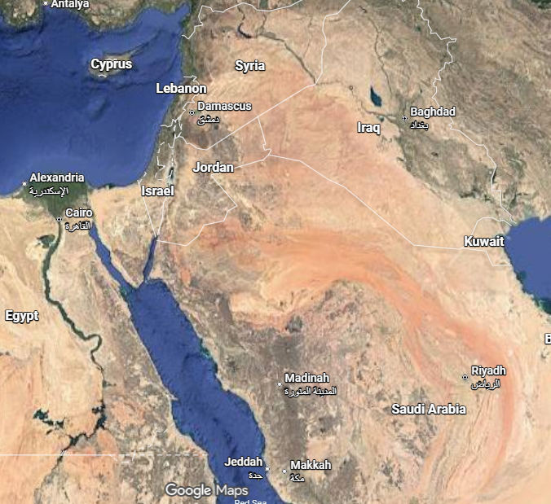
Law vs. Promise
Ch. 3 -

Slide 8
Law vs. Promise – Slaves and Sons
Galatians 4:21-31
  2 Sons – Slave and Free – Hagar and Sarah – Ishmael and Isaac
  Ishmael – “Religion” and works, Wandering
  Isaac – Promise and Substitution
Galatians 4:1-7 – At the right time, we were adopted through faith Christ!

Slide 9


