Slide 1
Law & Freedom
Galatians 5:1-15
Pastor Daniel Klem
Sunday, April 12, 2026

Slide 2
Law vs. Promise
Galatians 1-2 – No other gospel, All-in Faith
Galatians 3
  Personal faithfulness vs. God’s faithfulness
  Obedience to the Letter vs. Faith in the Word
  Adherence to tradition vs. Love of God, people, & the Church
Galatians 4
  Bad Religion (Our Works)
  vs. Good Religion (God’s Works)

Slide 3
Law vs. Promise
Galatians 5:1-15
  vv. 1-6: Freedom and Obedience
  vv. 7-12: Listening to whom?
  vv. 13-15: Freedom and Obedience

Slide 4
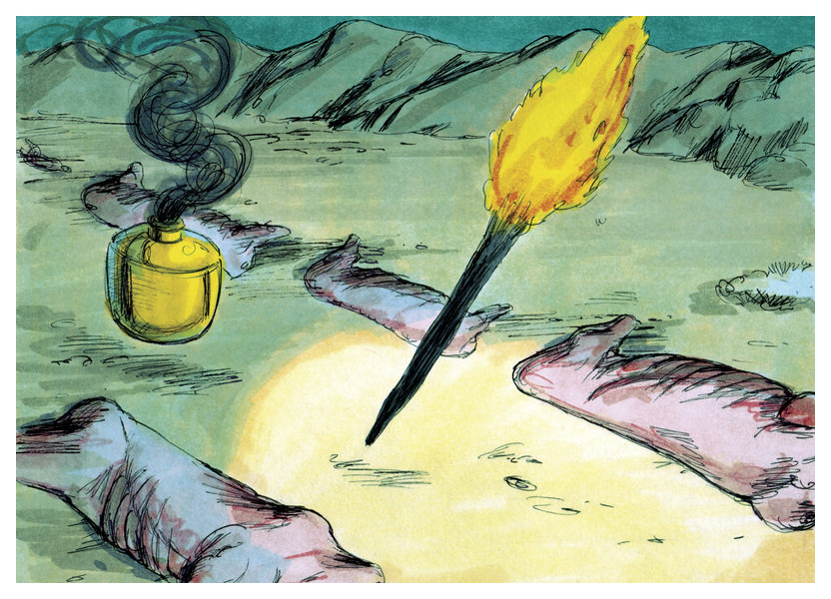
Israel’s (& humanity’s) History
Genesis
  Creation of all things, especially Us
  The Fall and continued falling
  Abraham to Egypt
    Land & Blessing
    Circumcision

Slide 5
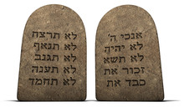
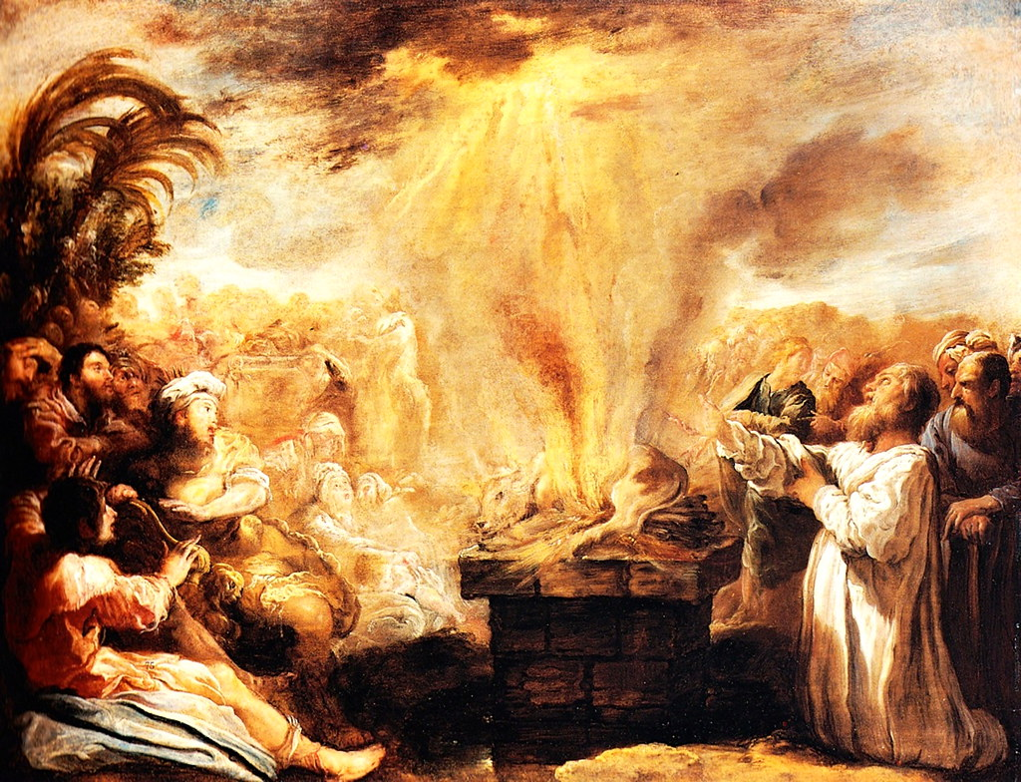
Israel’s History
Exodus through Exile
  Redemption & Rebellion
  Judges – “Living your truth”
  Kings – 3 together, many apart
  Exile – Amos 2:4-8
    Ignoring the Law
    Ezra & Nehemiah

Slide 6
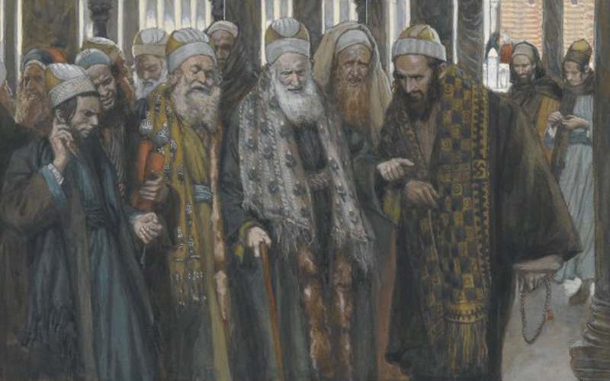
Israel’s Leadership & Factions
Sadducees
Pharisees
Essenes
Zealots
Regular People
This Photo by Unknown Author is licensed under CC BY-SA-NC

Slide 7
Freedom & Obedience
Galatians 5:1-6
  “severed from Christ … fallen from grace”
  Forcing tradition (Matthew 23:1-36)
  Neglecting tradition (Antinomianism; Matthew 7:21-23; 25:31-46)
  Acting from love (John 14:15)

Slide 8
Listening to Whom?
Galatians 5:7-12
  “Who hindered you?”
  (1 Corinthians 15:33; Matthew 16:5-12)
  “bear the penalty”
  (1:6-10; 5:12; Matthew 18:1-9)
  Run well.

Slide 9
Freedom & Obedience
Galatians 5:13-15
  Sin in grace? (Romans 6)
  “Love your neighbor as yourself.”
    Fear dominates, Love frees
    Do not bite and devour each other, but love one another (John 13:34-35)

Slide 10
Living in the Promise
Matthew 15:1-9 (Isaiah 29:13)
  Not forcing traditions nor allowing sin
  Matthew 23:1-36
Philippians 2:1-11
1 Thessalonians 5:11-15
Jude 17-23
Galatians 5:16; 6:1-2

